Slide 1





HTML, CSS/SCSS, SEO
by Bohdan Zhylavskyi
magnise.com

Slide 2
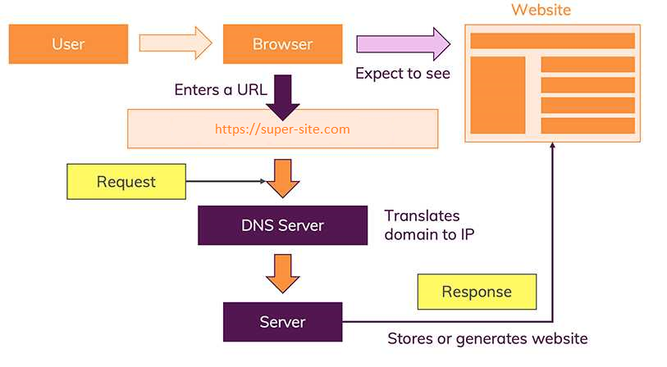

Slide 3
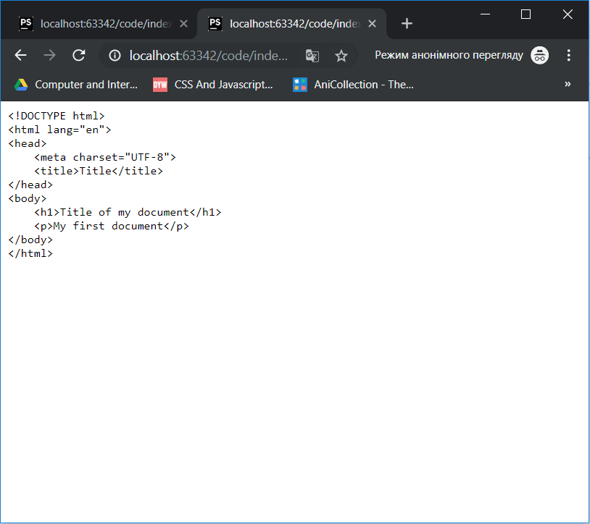
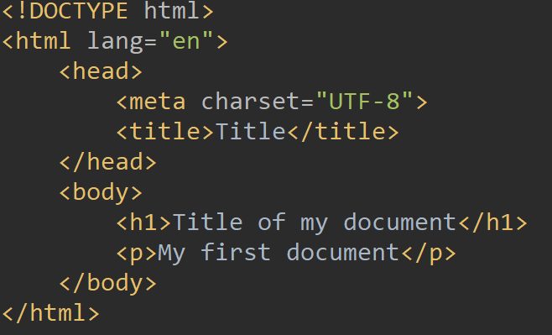
index.txt

Slide 4
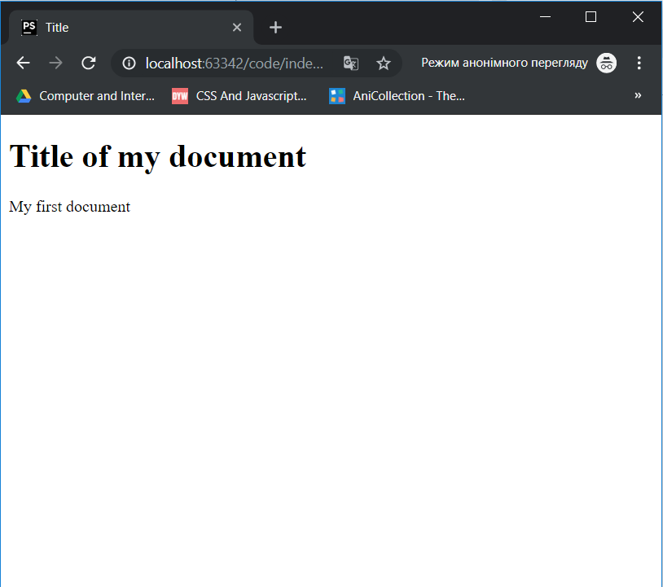
index.html

Slide 5
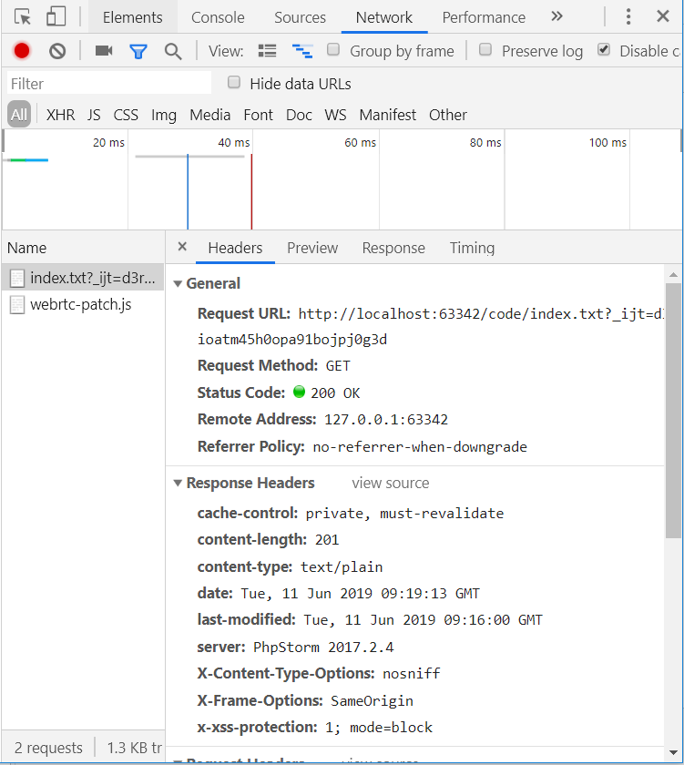
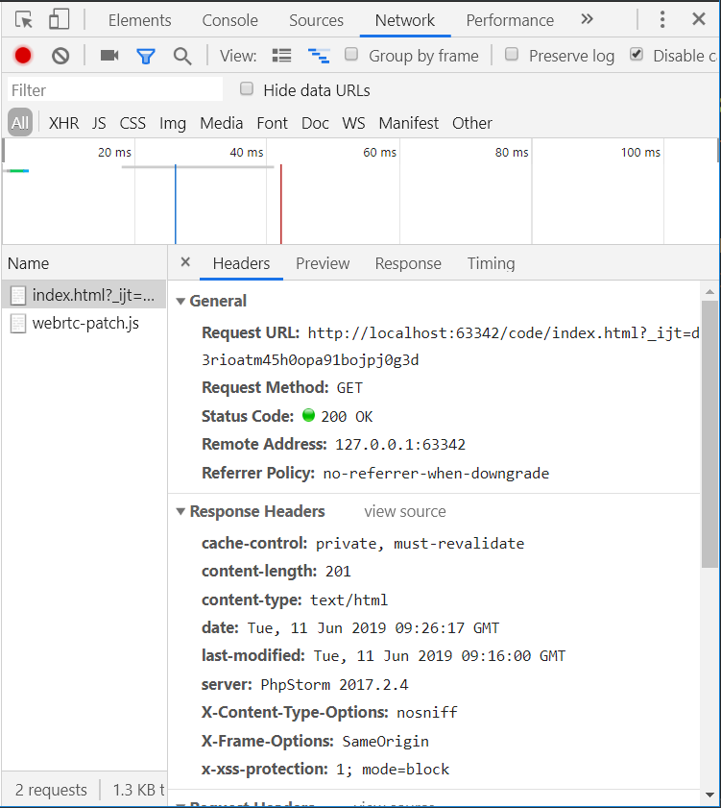

Slide 6
What is HTML?
HTML (Hypertext Markup Language) is the code that is used to structure a web page and its content.
A markup language is a computer language that defines the structure and presentation of raw text.
HTML define the syntax and rules for using special language built-in instructions - tags that
are not reproduced by the browser, but indicate to them how to display the contents of the document.
HTML is not programming language.

Slide 7
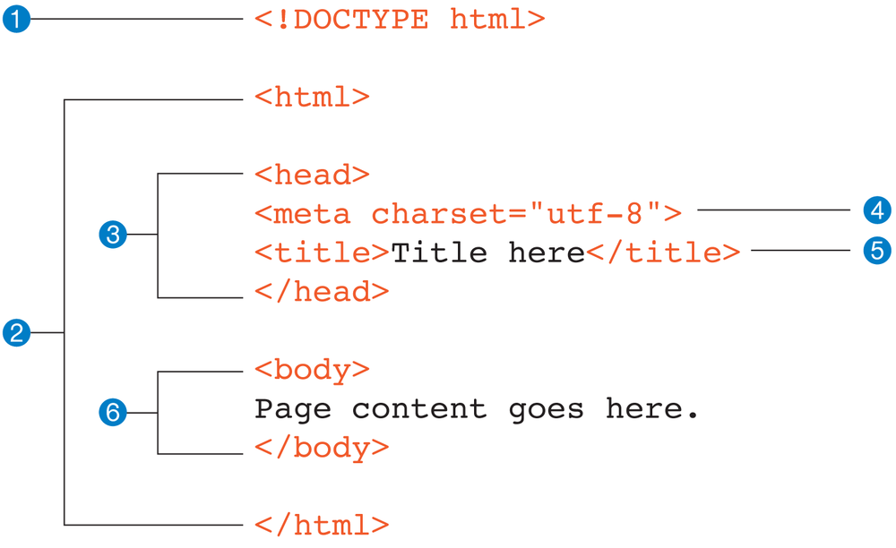

Slide 8
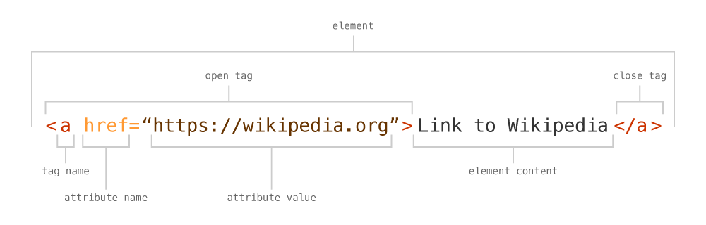
HTML element — a unit of content in an HTML document formed by HTML tags and the text
or media it contains.
HTML Tag — the element name, surrounded by an opening (<) and closing (>) angle bracket.
Element Attribute — are modifiers for the HTML tags and they provide additional information.
Element Content — The information (text or other elements) contained between the opening and
closing tags of an HTML element.

Slide 9
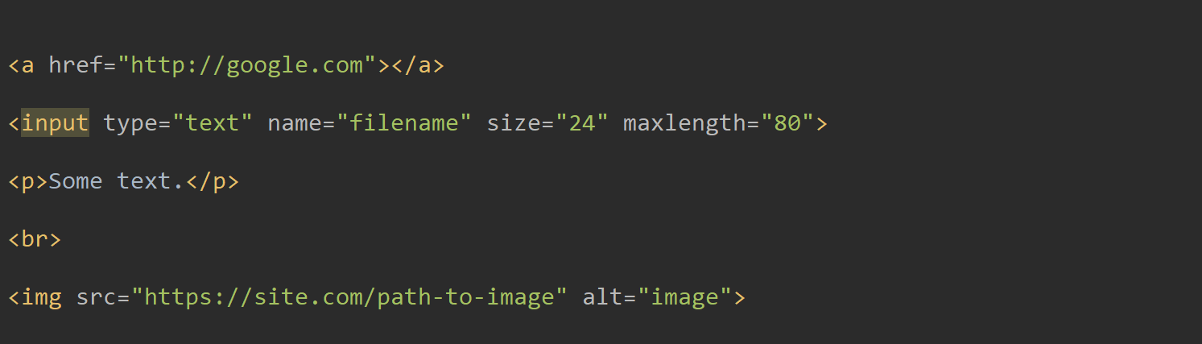
HTML elements example

Slide 10

<head>Tag
The <head> element can include a title for the document, scripts, styles, meta information, and more.
The following elements can go inside the <head> element:
<title> - used for set document title (browser tab title)
<style> - used for add style to document
<link> - used for including external style to document
<meta> - used for metadata
<script> - used for including JavaScript to document

Slide 11
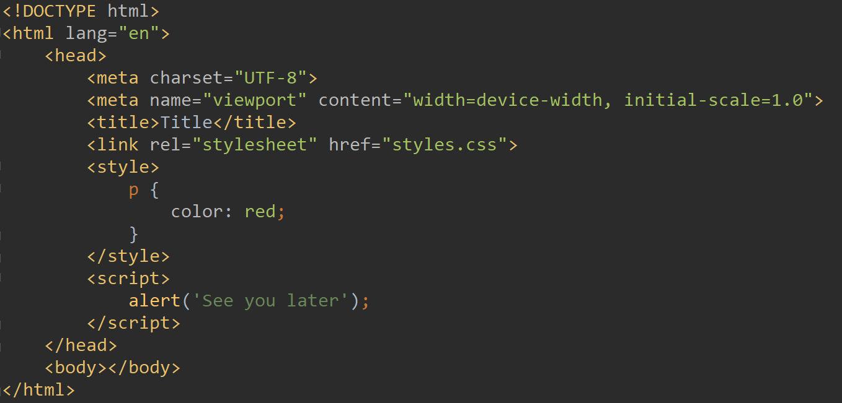

Slide 12
<body> Tag
The <body> tag defines the document's body.
The <body> element contains all the contents of an HTML document:
text
hyperlinks
images
tables
list
etc

Slide 13
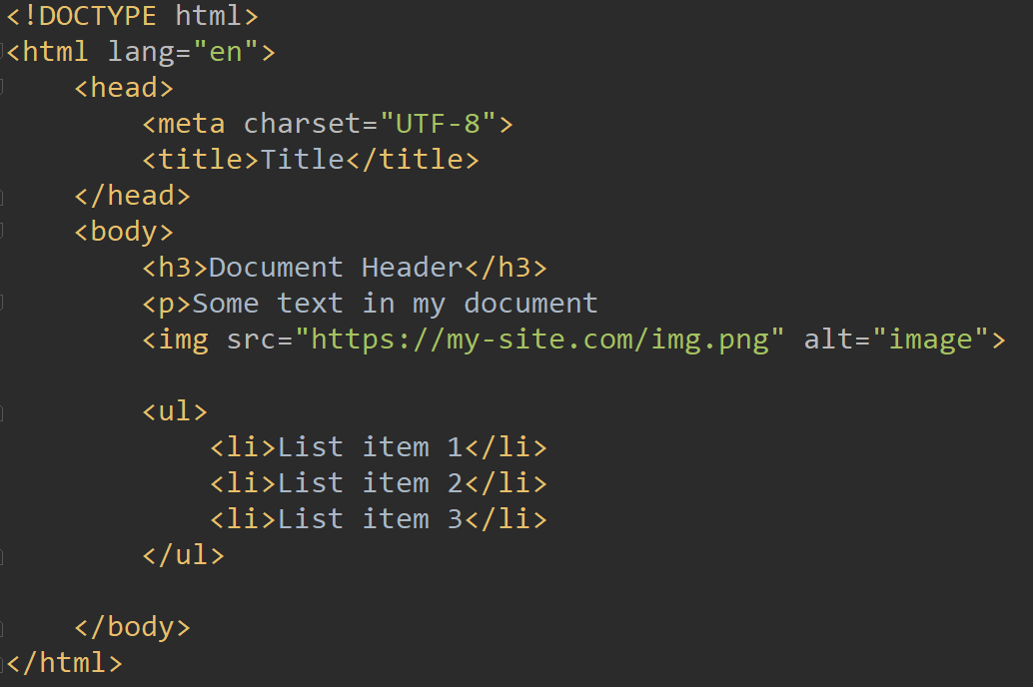
Exampleof body tag

Slide 14
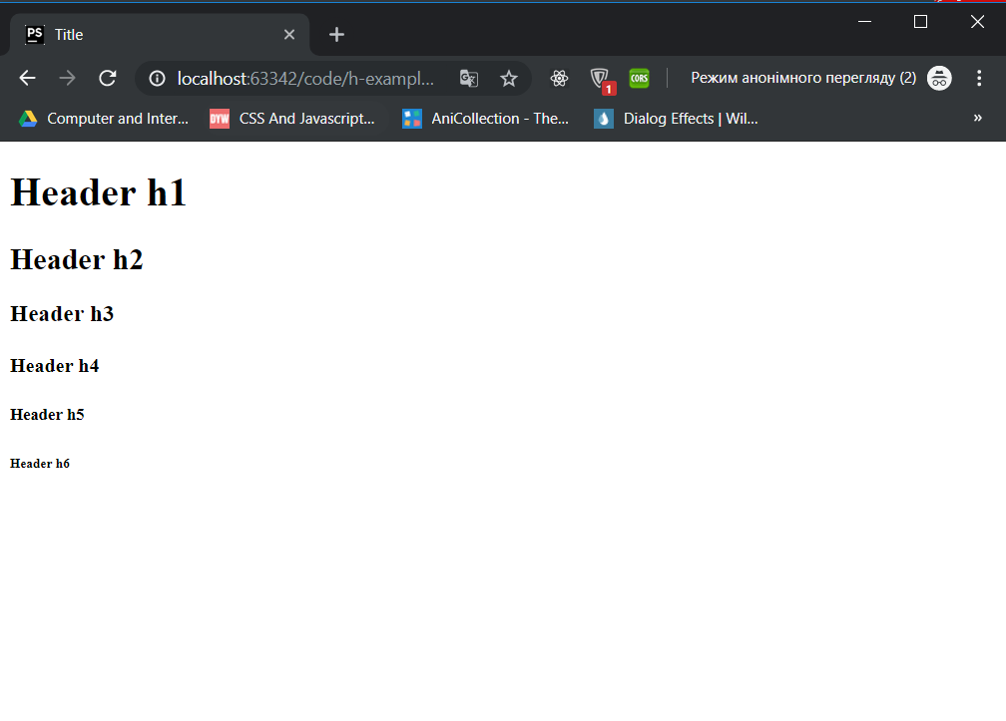
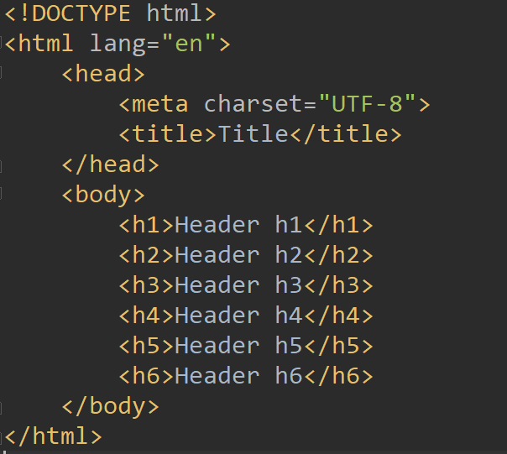
Headers

Slide 15
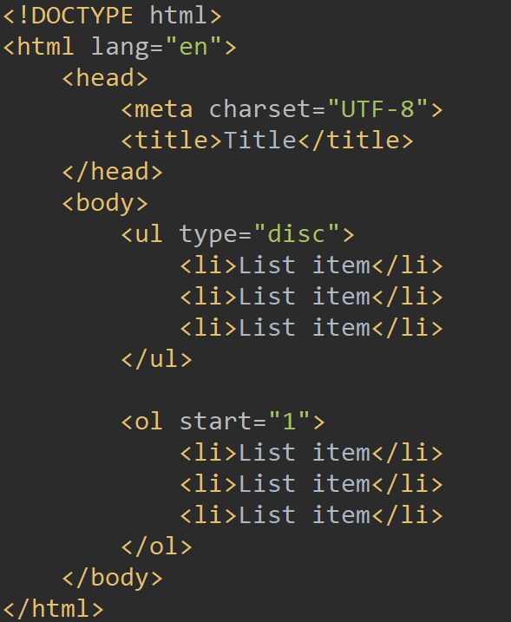
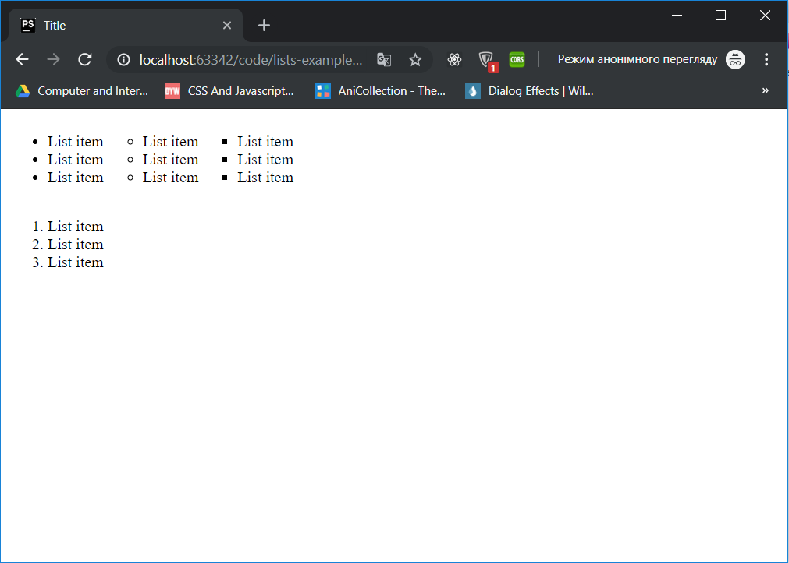
Lists

Slide 16
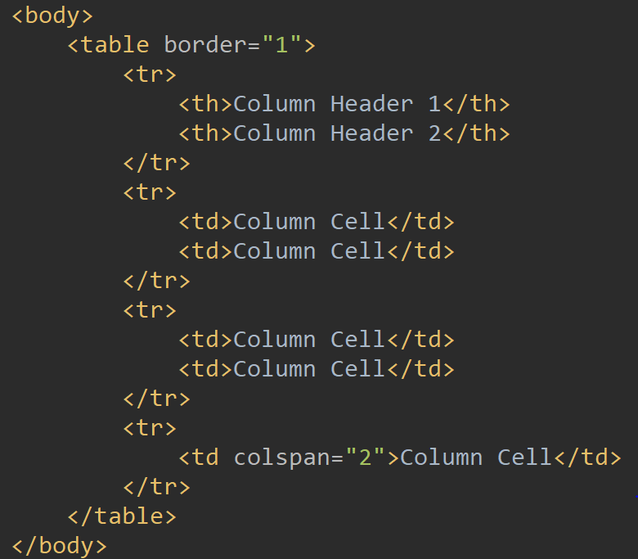
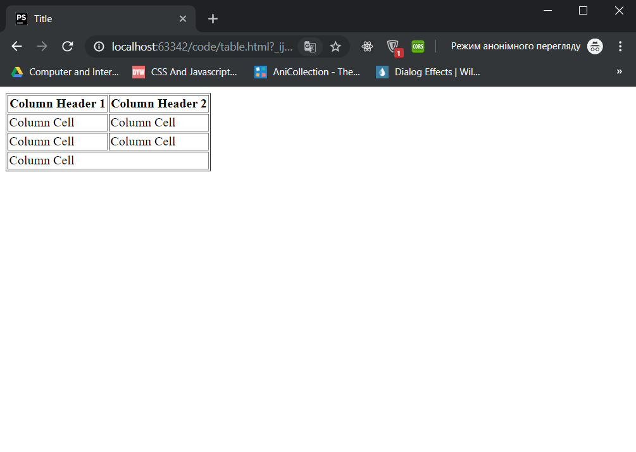
Tables
List tags

Slide 17
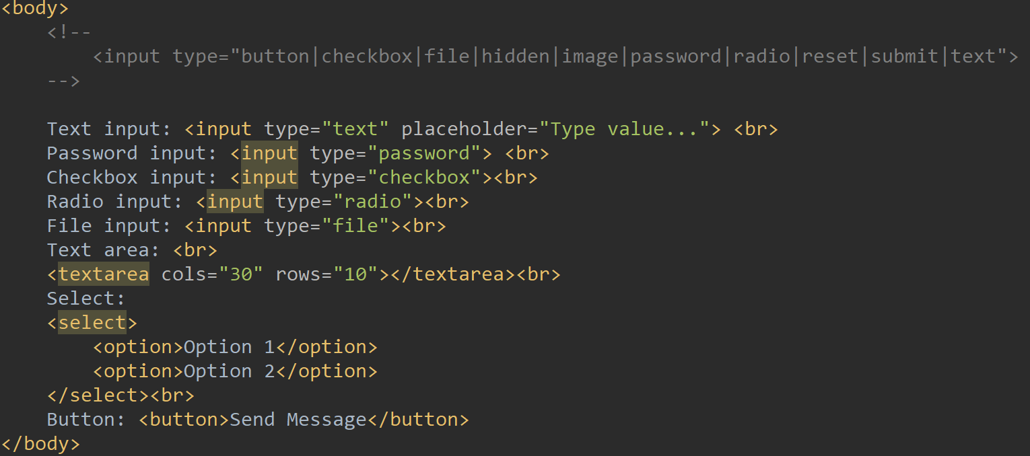
Inputs
List tags

Slide 18
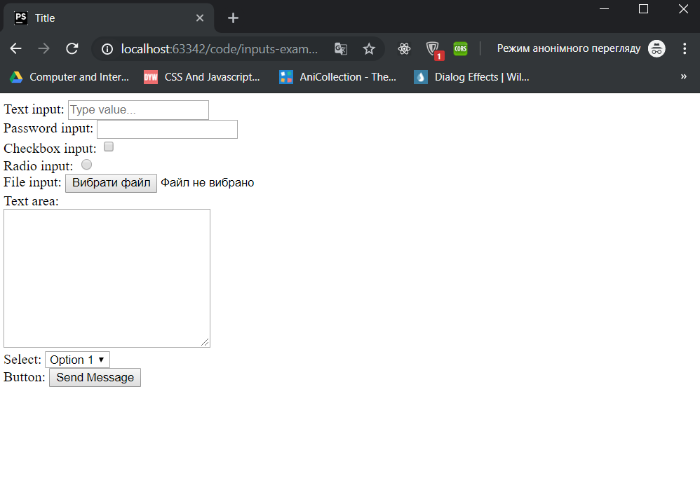

Slide 19
What is CSS?
CSS stands for Cascading Style Sheets
CSS describes how HTML elements are to be displayed on screen
CSS saves a lot of work. It can control the layout of multiple web pages all at once

Slide 20
What is CSS?
CSS stands for Cascading Style Sheets
CSS describes how HTML elements are to be displayed on screen
CSS saves a lot of work. It can control the layout of multiple web pages all at once

Slide 21
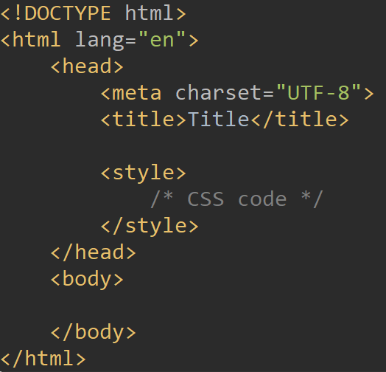

Slide 22
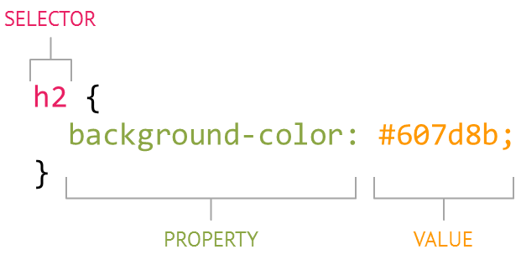
CSS syntax

Slide 23
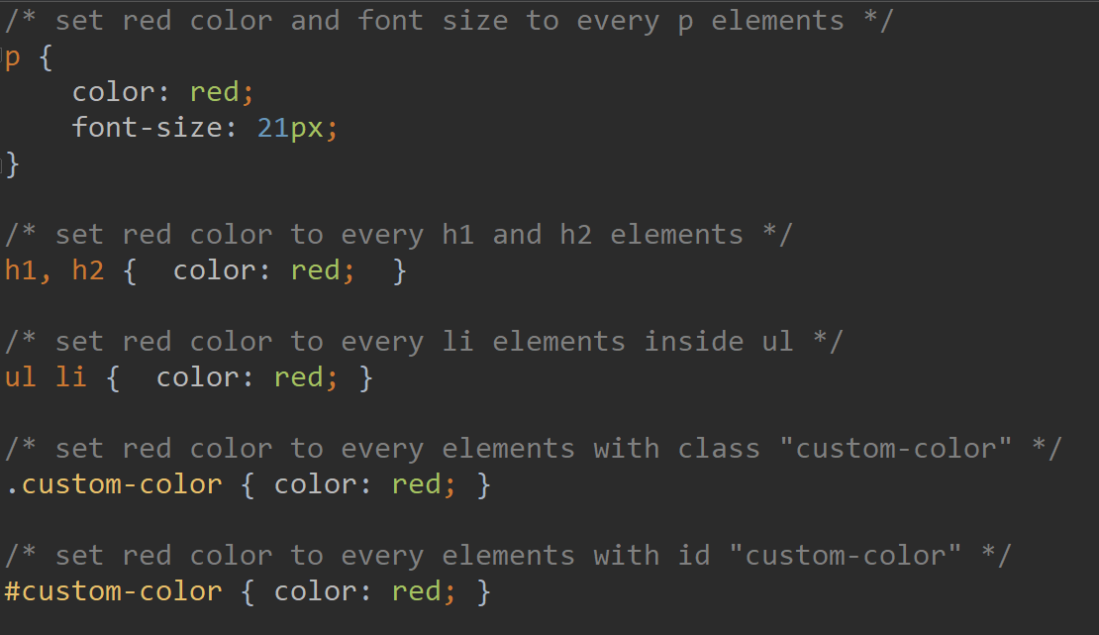

Slide 24
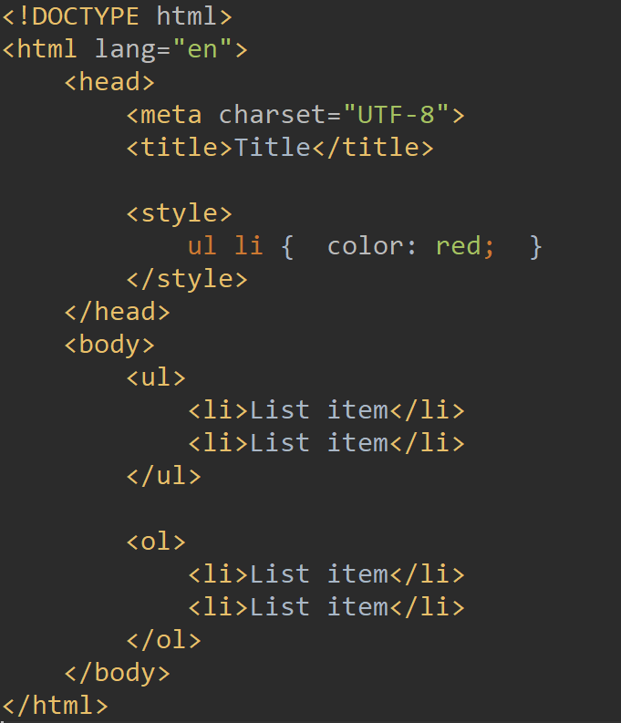
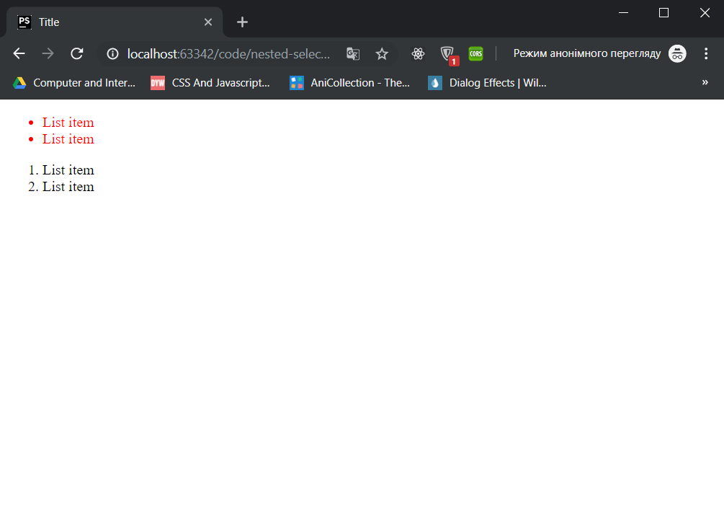

Slide 25
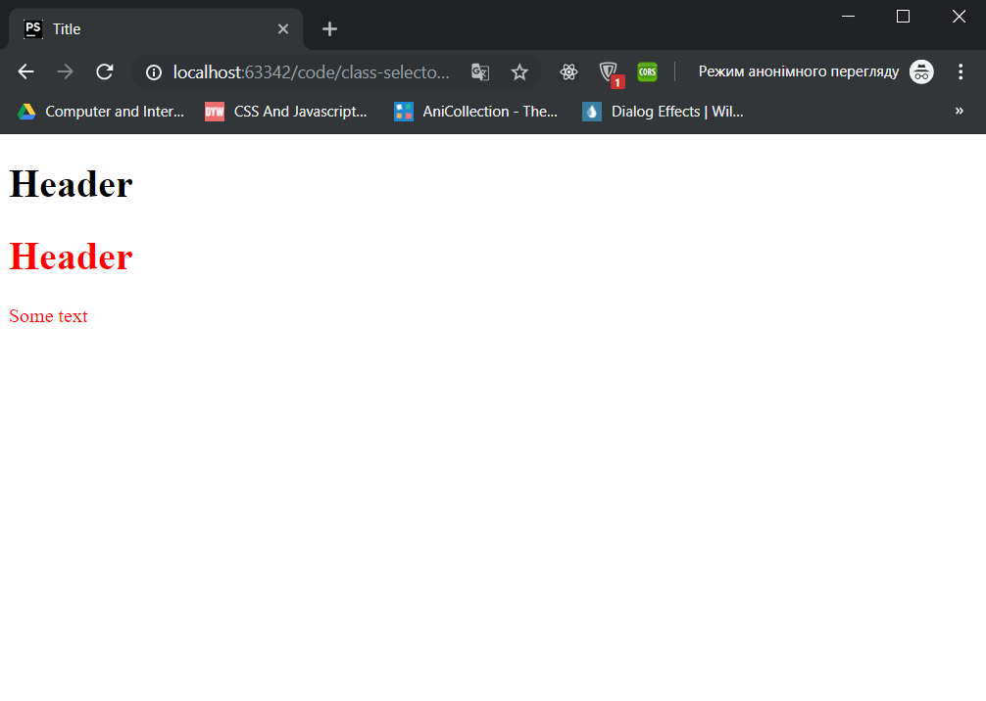
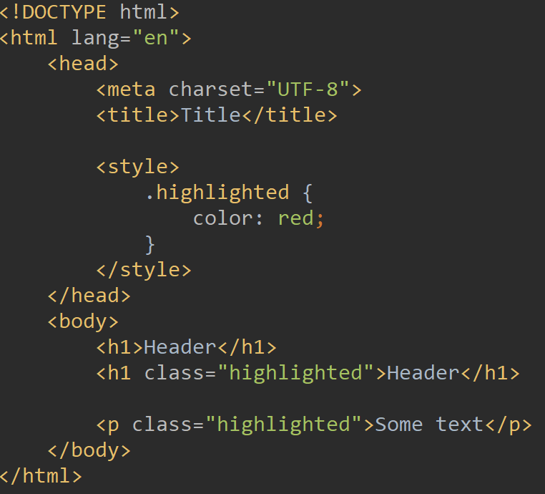

Slide 26
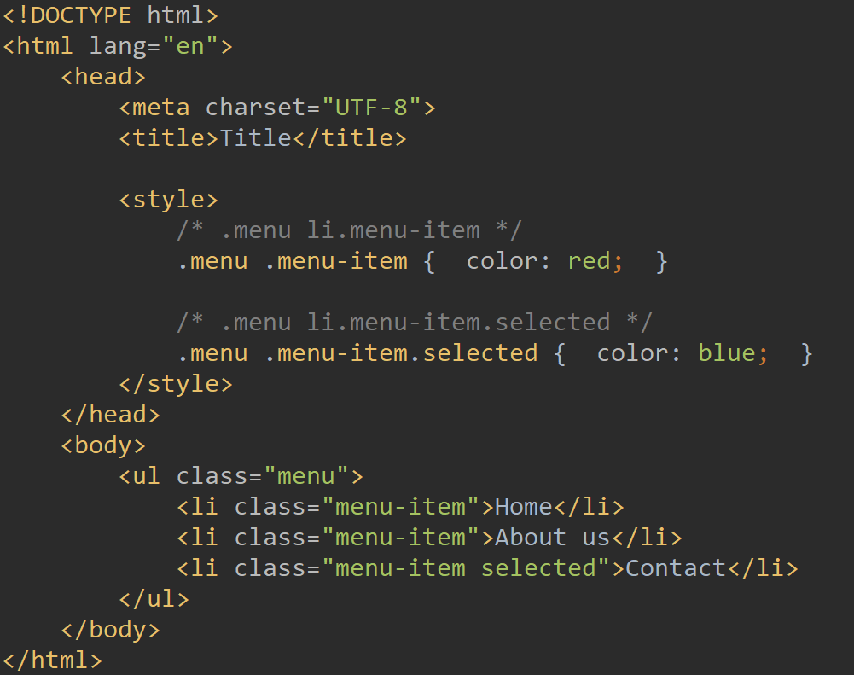

Slide 27
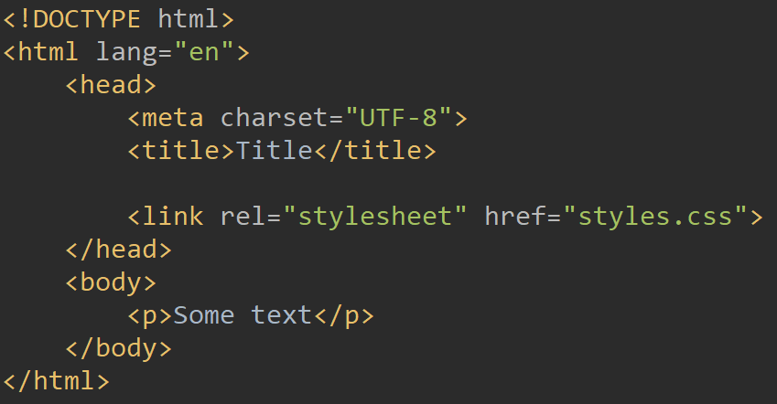
External style sheets

Slide 28
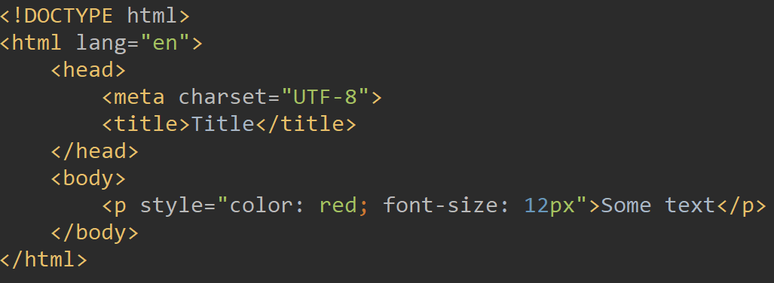
Inline styles

Slide 29
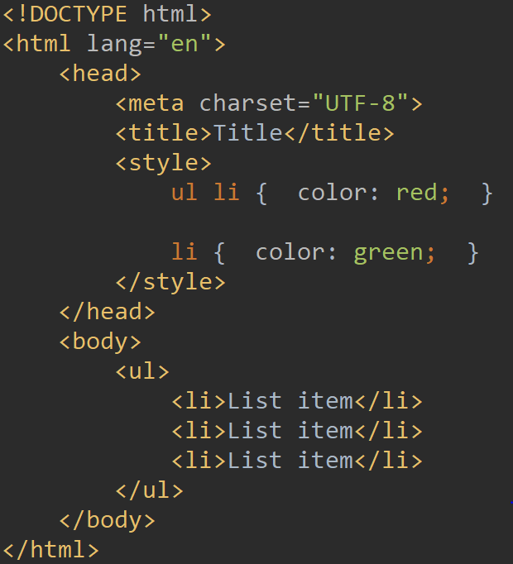
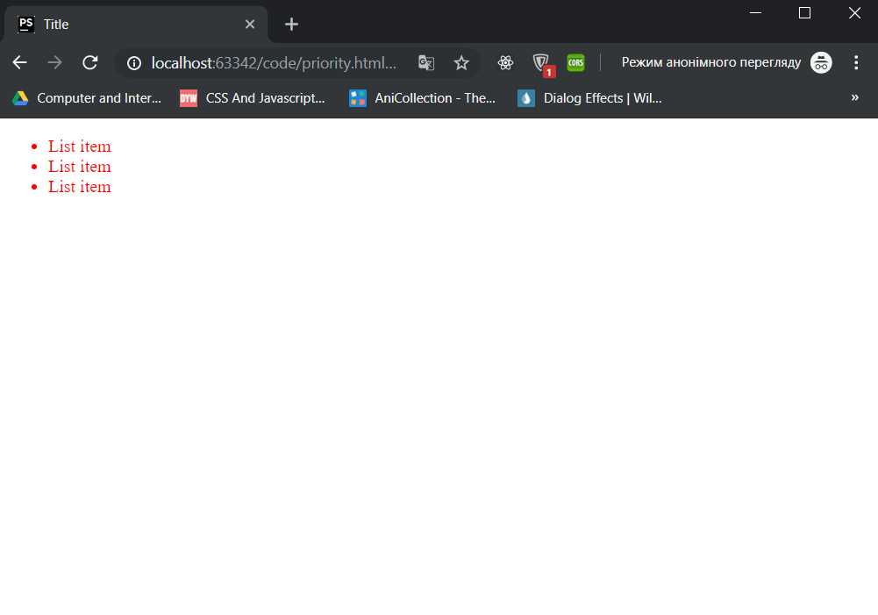

Slide 30
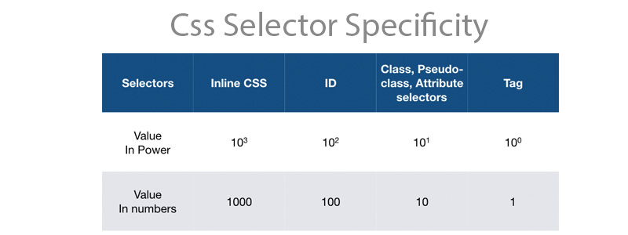
p { color: red;} -- 1
.container p { color: red;} -- 10 + 1 = 11
.container p#custom { color: red;} -- 10 + 1 + 100 = 111
<p style=“color: red;”> -- 1000
p { color: red !important; } -- 1 + 10000 = 10001

Slide 31
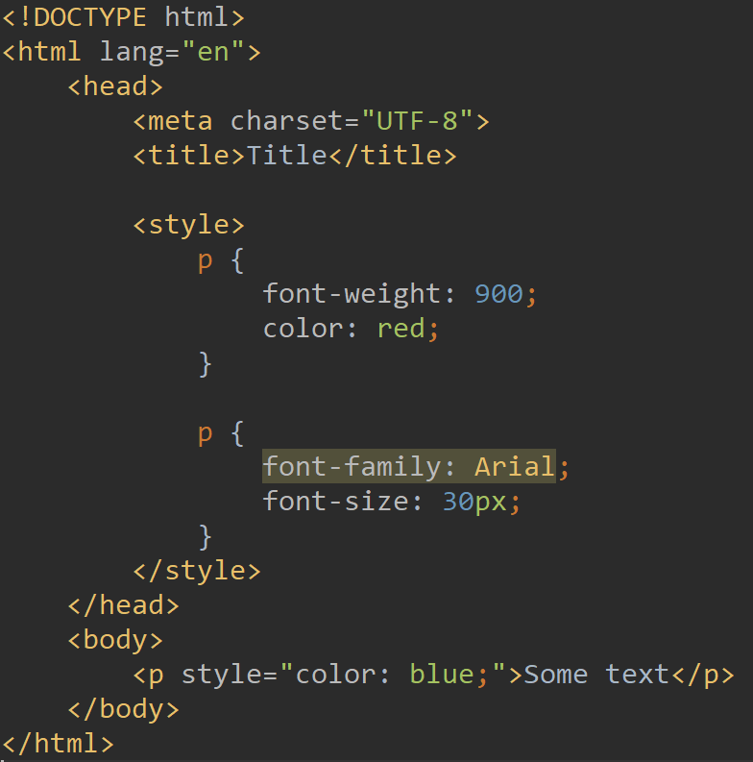
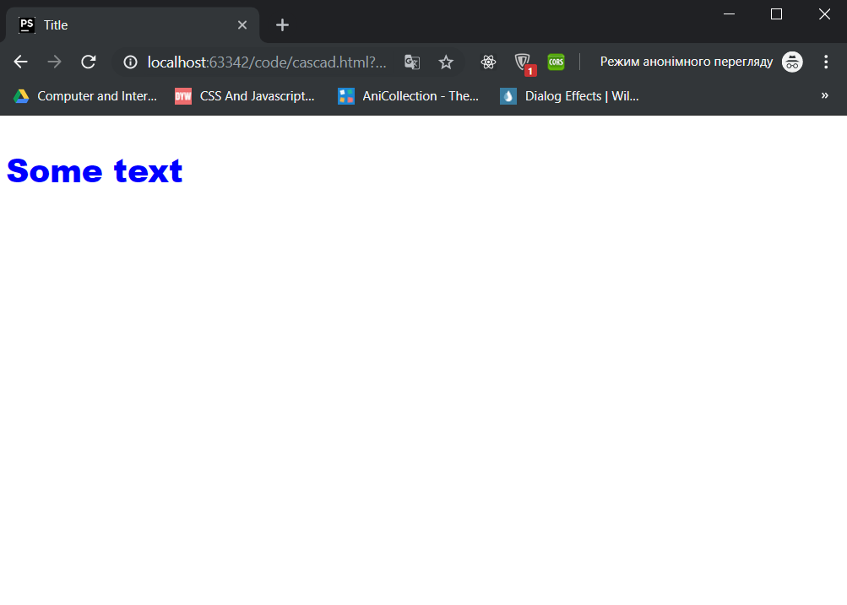

Slide 32
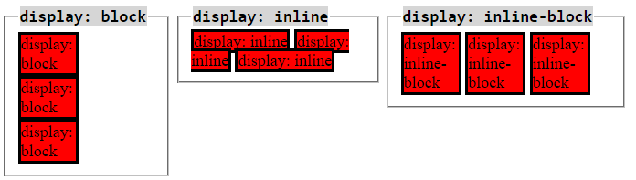
Display

Slide 33
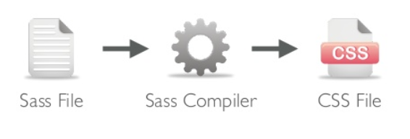
Sass
Sass - Syntactically Awesome Style Sheets. CSS preprocessor.
Preprocessor - program that takes one type of data and converts it to another type of data
CSS Preprocessor - program that takes one type of data and converts it to CSS
CSS preprocessors:
LESS
Stylus

Slide 34
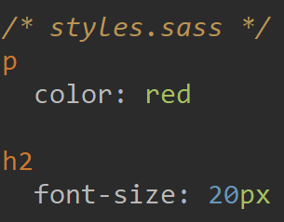
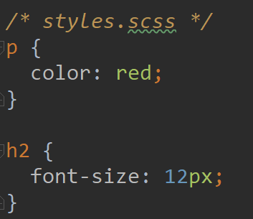
.sass vs .scss

Slide 35
sass input.scss output.css

Slide 36
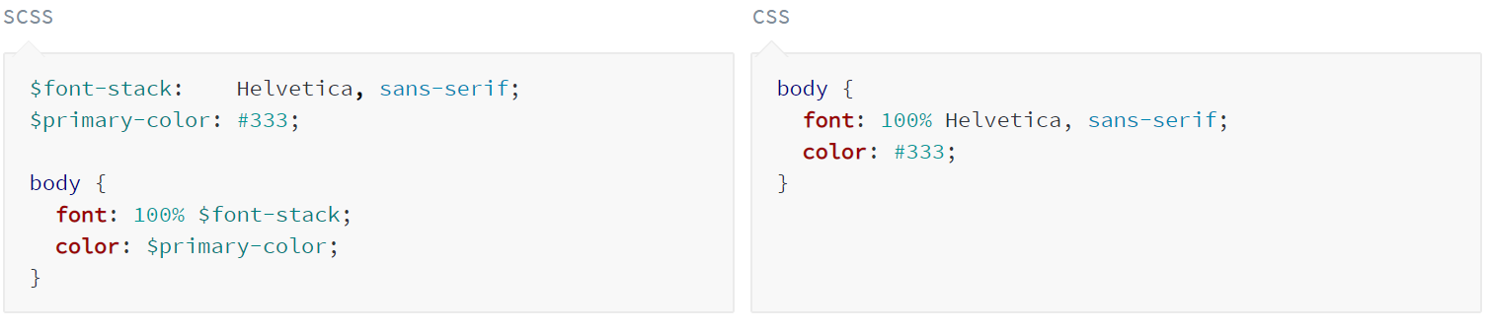
Variables

Slide 37
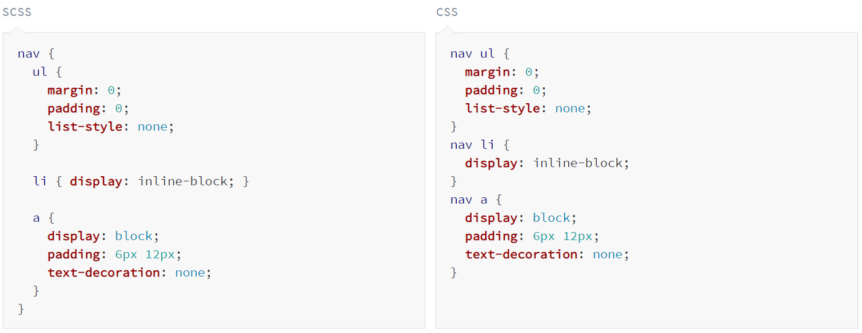
Nesting

Slide 38
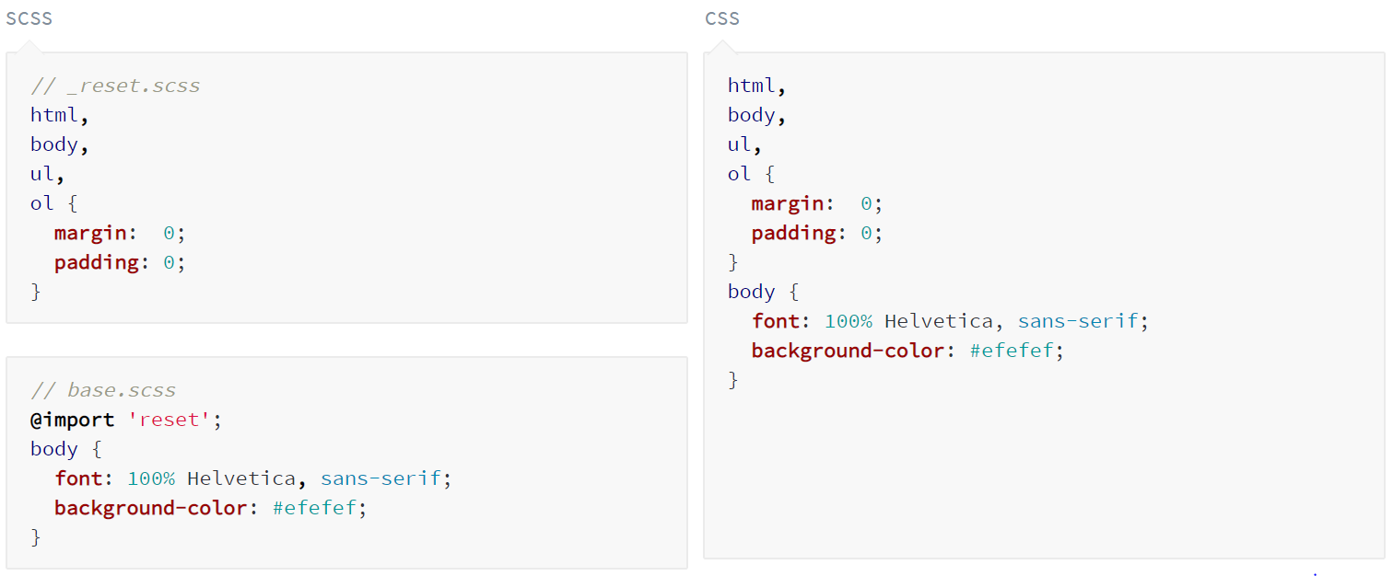
Import file

Slide 39
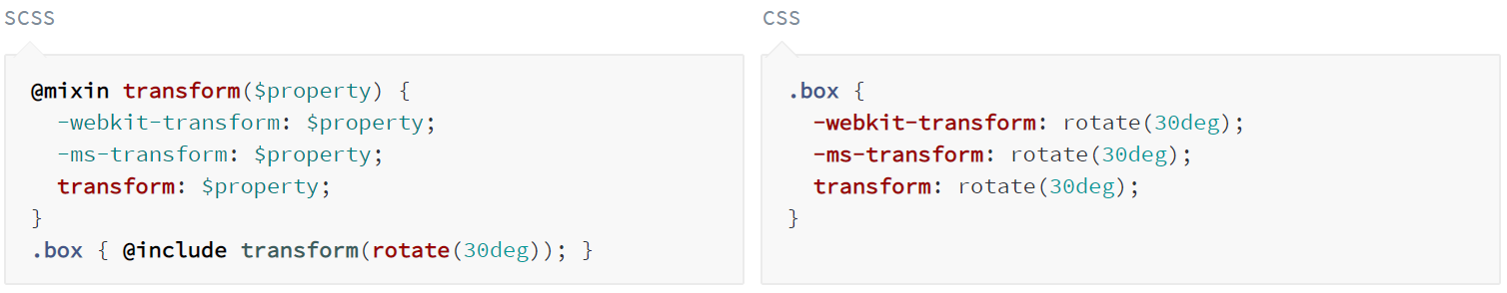
Mixins

Slide 40
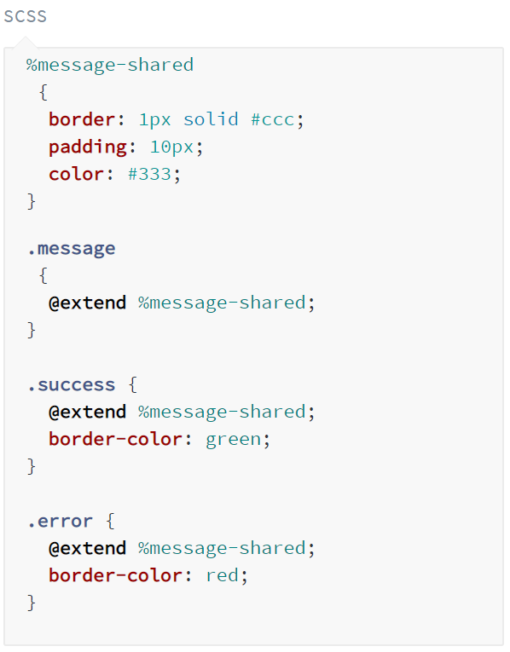
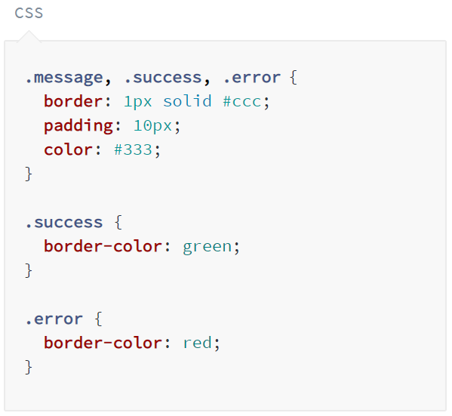
Extend

Slide 41
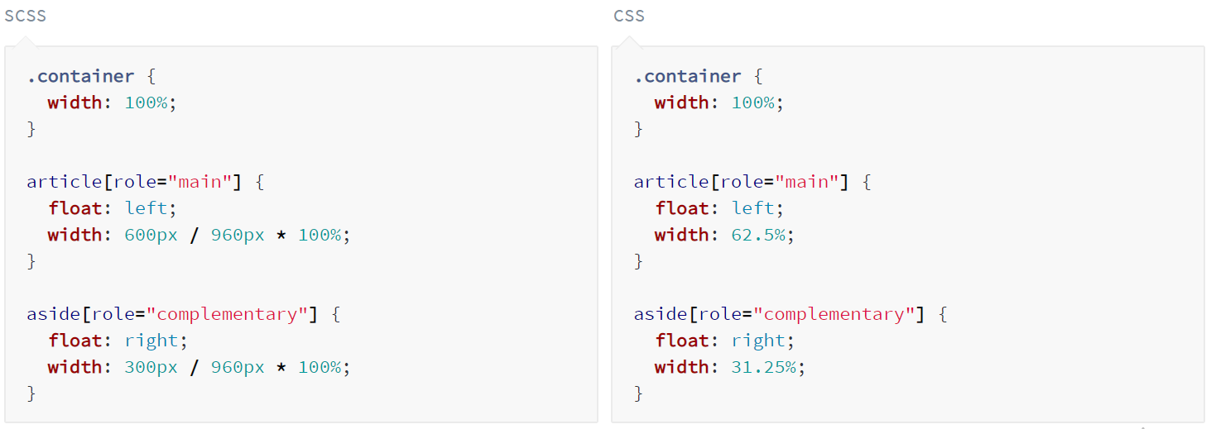
Operators (+, -, *, /, %)

Slide 42
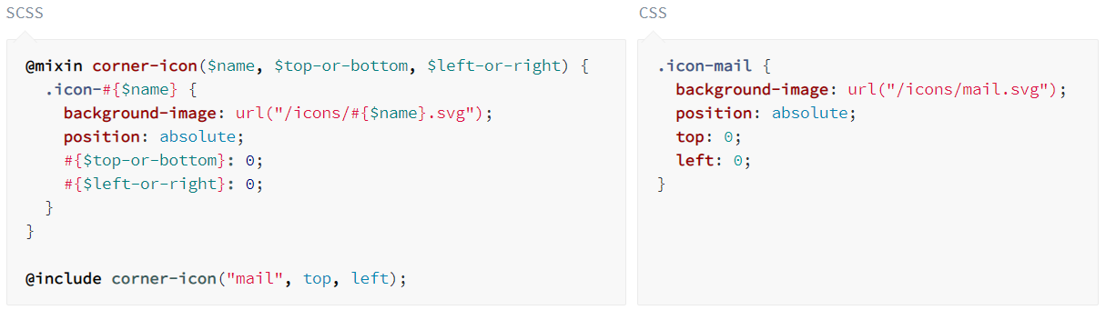
Interpolation

Slide 43
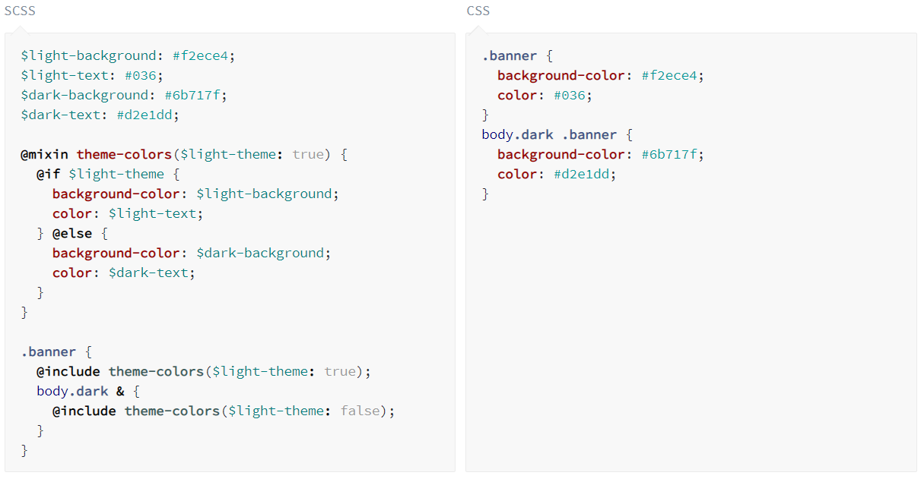
@if … @else

Slide 44
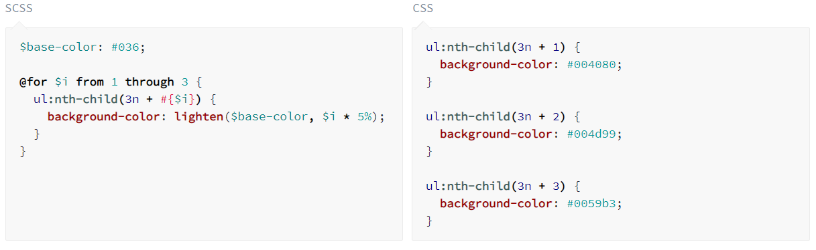
@for … from … to|through

Slide 45
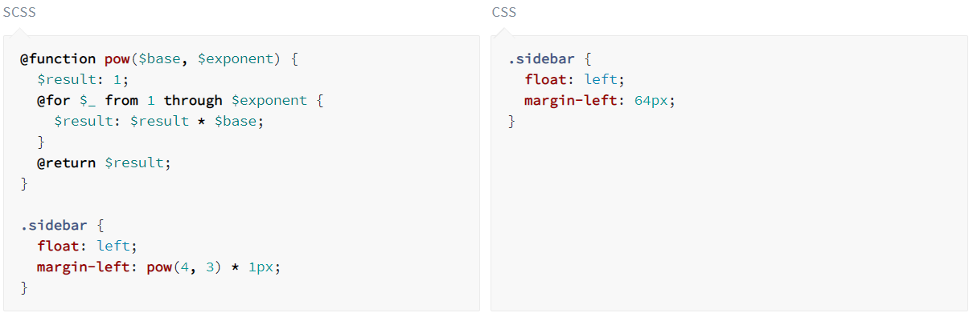
@function

Slide 46

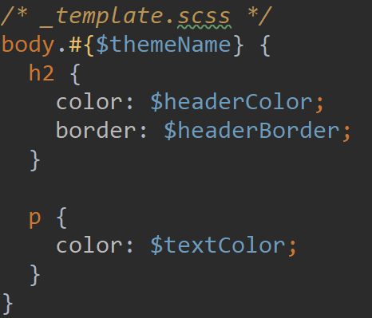




Slide 47


Slide 48

SEO
Search engine optimization

Slide 49
How do Google search algorithms work?
Analyze words – Google tries to understand the meaning of your search and decide
what strings of words to look up in the Search index.
Match a query – At the most basic level, Google analyzes how often and where keywords relevant
to your query appear on a page.
Rank pages – Using hundreds of factors, Google tries to identify the best web pages
that match your search query.
Consider context – Information such as user’s location, past search history, and Search settings
all help Google personalize results to what is most useful and relevant for that particular user
Return best results

Slide 50
Internal SEO optimization
User friendly URL (/programming)
Use title and description tags
Use multimedia (images, videos) - increase the time spent on the site
Use links to reliable sites
Use h1 … h6 tags
Use alt attribute in image tag
Quality content

Slide 51
External SEO optimization
Use links to your site in social networks
Link exchange
Publication in the media
Use blogs
Satellite sites

Slide 52
Factors reducing the rating of the site
Duplicate Content
Too many numbers of external links
Slow or unavailable websites
Keyword Stuffing
Guest posting for links

Slide 53

Finish!

